Slide 1
What gives forests ?
„Forests in Poland and Europe.
Characteristics and management”

Slide 2
What gives forests ?
Our precious forests provide many benefits to the human population. They help clean our air, protect our watersheds, are one of the most important renewable resources for meeting many human needs, and provide the place for much of our outdoor recreation. For many of us the forests are a place of spiritual renewal where we go to get away from the business of every day life and connect with the mysteries of the universe. Without our forests human life would be much different. Yet because of the size and growth of the human population we are placing tremendous stress on them. Climate change, acid rain, development, fragmentation, conversion of forest land to agricultural land, and industrial-type forestry practices are all changing the quality of our forests and, in many areas, the quantity of our forests.

Slide 3
Forest Europe growing live
Polish forests cover about 30% of Poland's territory, and are mostly owned by the state. Western and northern parts of Poland as well as the Carpathian Mountains in the extreme south, are much more forested than eastern and central provinces.The most forested administrative districts of the country are:
Lubusz Voivodeship (48,9%),
Subcarpathian Voivodeship (37,2%),
Pomeranian Voivodeship (36,1%).
The least forested are:
Łódź Voivodeship 21%),
Masovian Voivodeship (22,6%)
Lublin Voivodeship (22,8%).

Slide 4
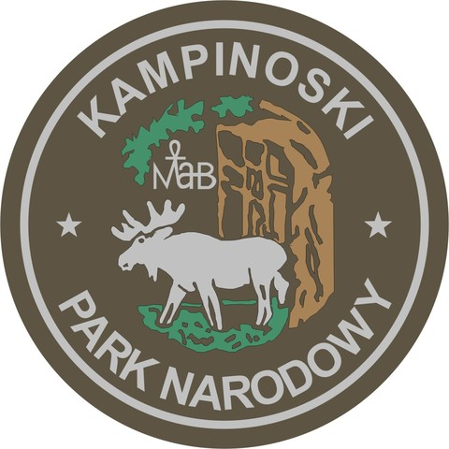
Kampinos Forest (Polish: Puszcza Kampinoska) is a large forest complex located to the west of Warsaw in Poland. It covers a part of the ancient valley of the Vistula, between the Vistula and the Bzura river. Once a forest covering 670 km² of central Poland, it currently covers roughly 240 km². Most of the Kampinos forest is currently covered by Kampinos National Park (Kampinoski Park Narodowy). Among the distinctive features of the area is a combination of sandy dunes and marshes, with dense pine and spruce forest.

Slide 5
Fauna
The Kampinos fauna consists of an amazing number of rare species. Unlike other big European cities, only Warsaw can boast so many species of animals living in the wilderness, close to such a huge human agglomeration. The emblem of the Kampinoski National Park is the elk (Alces alces, North American - moose), which lives here again after 150 years of its absence from the Park. The European beaver (Castor fiber) was reintroduced in 1980, after several hundred years of absence, while the lynx (Lynx lynx) returned to the park in 1992. Also the red deer (Cervus elaphus), the roe-deer (Capreolus capreolus), wild boar (Sus scrofa), badger (Meles meles) and the fox (Vulpes vulpes) inhabit the forest.
A great number of birds live in the Park , since it is located on a bird migration route. Crane (Grus grus), black stork (Ciconia nigra), white stork (Ciconia ciconia), common heron (Ardea cinerea), and raven (Corvus corax), inhabit the area. Nearly twenty bird of prey species nest in the Kampinos Forest, including the lesser spotted eagle (Aquila pomarina), the honey buzzard (Pernis apivorus), as well as great numbers of buzzards (Buteo buteo), and goshawks (Acipiter gontilis). The European golden eagle (Aquila chrysateos), the white-tailed eagle (Haliaetus albicilla), and the osprey (Pandion haliaetus), were observed many times. With the inclusion of amphibians, reptiles and insects, over 4,000 species of fauna live in the Kampinoski National Park.

Slide 6
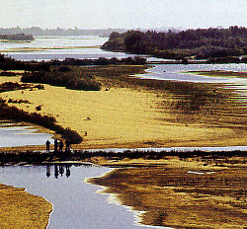
The symbol of the Park is the elk (Alces alces, North American - moose), one of the most popular game animals in this region.

Slide 7
Vegetation
The abundance of plant life is due to the Park's location at a conglomeration of river valleys, as well as to the morphological variety of its soil and variable water conditions. The flora of the Kampinos Forest includes species typical of many geographic environments including glacial, Atlantic or mountainous. Even some halophytes and Pontian xerophytes live in the Park. Among the 66 rare and protected species, the most interesting are Chamaedaphne calyculata, sour cherry (Cerasus acida) and river birch (Betula obscura). The forest is embellished by Martagon lily (Lilium martagon), mezereon (Daphne mezereum), Corydalis colidaand Corydalis cava, a few species of pasque-flower (Pulsatilla), a mass of lily of the valley (Convallaria maialis) and other beautiful plants.
There are altogether 1,100 species of vascular plants including 27 species of trees and 40 species of shrubs growing in Poland. Some of the trees are of immense size, especially oak (Quercus robur) and small-leaved linden (Tilia cordata). In the protection zone, some imposing cottonwood (Populus alba) and black poplar (Populus nigra) trees may be found. Yew (Taxus baccata) has been reintroduced into the Park.

Slide 8
Human environment
Some area of the Park is owned by farmers, who live in the villages within the park boundaries (together they make ca. 3,000 inhabitants). This creates a problem and poses a threat to the protected environment. The Park's plan to buy villages out is hampered by the lack of financial means.
The territory of the Kampinoski National Park has close ties with history. The park was the site of many battles, including those fought in September 1939, i.e. the first month of the Second World War. The Park and its surroundings contain many graves of Polish insurgents of 1831, 1863, soldiers and partisans of WW II, killed in the Kampinos Forest. There are cemeteries of Nazi victims like the one at the Palmiry village, where a number of Poles and Jews were shot and then buried in mass graves.
In the Park's protection zone there are some historic and architectural monuments of great value. Thousands of tourists visit the museum located in the small mansion at Zelazowa Wola, where Frederic Chopin was born in 1810. He was baptized at the nearby Brochow defensive church, built in the 16th century of red brick.

Slide 9
Temperate forests
Temperate forests correspond to forest concentration formed in the northern and southern hemisphere, or in temperate regions. Main characteristics include: wide leaves, large and tall trees and non seasonal vegetation. Temperate forests can be further distinguished by weather patterns and geographical features that favor the predominance of certain kinds of trees. In temperate coniferous forests, evergreen conifers predominate, while in temperate broadleaf and mixed forests, a more even distribution exists between evergreen and deciduous trees. Temperate deciduous forests, a subgroup of temperate broadleaf forests, consist of trees that lose their leaves every year. Finally, temperate rainforests typically have heavy rainfall and dense humidity.

Slide 10
Sonian Forest
The Sonian Forest is a remnant of the centuries-old Silva Carbonaria (“ Charcoal Forest”), just like the Hallerbos, the Meerdaalwoud and the other Brabant forests. In the time of the Romans, the Silva Carbonaria extended from the banks of the Rhine and Moselle all the way to the North Sea.

Slide 11
Animals & Plants
The Sonian Forest teems with special animals and plants. Those deserve a place on this website. The category ‘Animals and plants’ gives you a glimpse into the world of the most striking species of the forest. This category is dynamic and is constantly growing based on input by naturalists, forest managers/administrators, foresters and visitors to the forest. Are you at home in the world of flora and fauna? Would you like to contribute to publicising the rich biodiversity of the forest all over the world? Then e-mail info[at]zonienwoud.be or info[at]foret-de-soignes.be without delay!

Slide 12
Mammals
No less than 46 species of mammal have lived in the Sonian Forest. We say ‘lived’, because since 1842 seven of these species of mammal have disappeared from the forest. The brown bear disappeared in the year 1000; the wolf in around 1810. The red deer was last seen around 1900. The boar was thought to have been extinct since 1957 but in 2006 new specimens were discovered roaming the wood. The last ones to have exited the stage some ten years ago were the badger, the hare and the hazel dormouse.

Slide 13
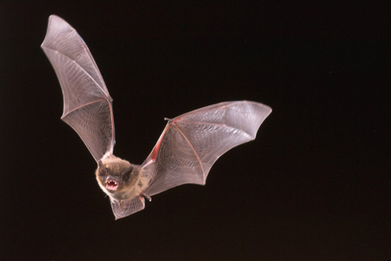
Bats—furry flutterers
Among the 39 mammals that live in the Sonian Forest today, fourteen of these are different varieties of bat. That is impressive, because there are only eighteen varieties in the whole of Belgium. This abundance can be explained by the great biological value of the forest and the suitable hunting grounds along its perimeter, especially above and around the pond-river complex of the Woluwe. The same is true of the area surrounding the lagoons of the IJse. The plains, with their shrubs and brushwood, in the open areas of the forest are also important hunting terrains. In addition to that, the bats prize the numerous dead trees in the forest reservations, for example, as places of shelter.

Slide 14
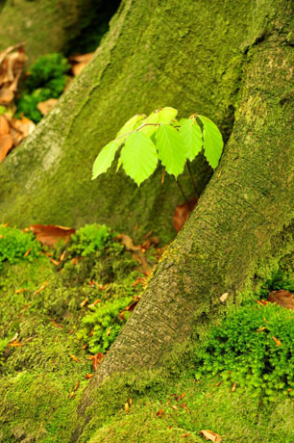
Exceptional trees
The beech: emblem of the Sonian Forest
Impressive, bolt upright beech trees reaching high into the sky: that’s what the Sonian Forest is known for. The Sonian Forest is certainly entitled to its nickname: the beech cathedral.
Nowadays, 70 percent of the Sonian Forest consists of beech trees. That dates from the time of the Austrian Habsburgs (1714-1795). The young Austrian landscape architect Joachim Zinner organised beech plantations on a massive scale. To this day, these form the majestic beech cathedral. Beeches older than 200 years are no exception. Beech wood was once used to make charcoal. Moreover, it is very suitable for furniture and toys because the wood is hard and does not splinter.

Slide 15
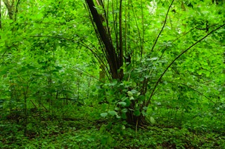
Delicious nuts: the haze
If there is one tree that is truly indigenous, it is the hazel. It colonised our region long before Belgium even existed. After the ice age, it was one of the first trees that formed woods here again. Archaeologists, by digging up large numbers of shells around settlements, have demonstrated that even our ancestors sometimes fancied a hazelnut. No wonder: the nuts are packed with fats and proteins and certainly helped prehistoric man to withstand the harsh winters.
The hazel is our earliest spring bloomer. Ornamental hazels distinguish themselves by curly twigs or reddish tinged leaves. The many twigged bush could use some shade, but has a difficult time under dense foliage. It can thus survive better in coppiced woods. It can be recognised by its large, nearly round leaves that are somewhat reminiscent of the large-leaved lime. But thanks to the double serrated edge and short tip at the top of its leaf, you can easily distinguish it. Its pliable wicker lends itself well to the heavier braided work, such as in braided walls.

Slide 16
Bibliography: www.fao.org/docrep/009/a0789e/a0789e02.html www.wikipedia.org

Slide 17
Zespół Szkół Elektronicznych i Ogólnokształcących im. prof. Janusza Groszkowskiego w Przemyślu
Aleksandra Kurasz
Ewelina Kuter
Beata Wajda
Kl. IIy

